Slide 1

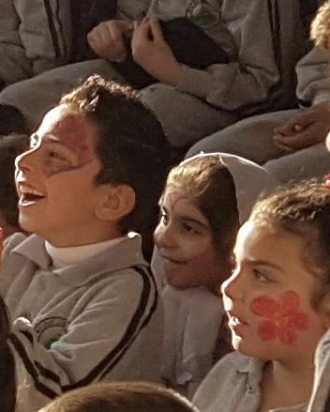
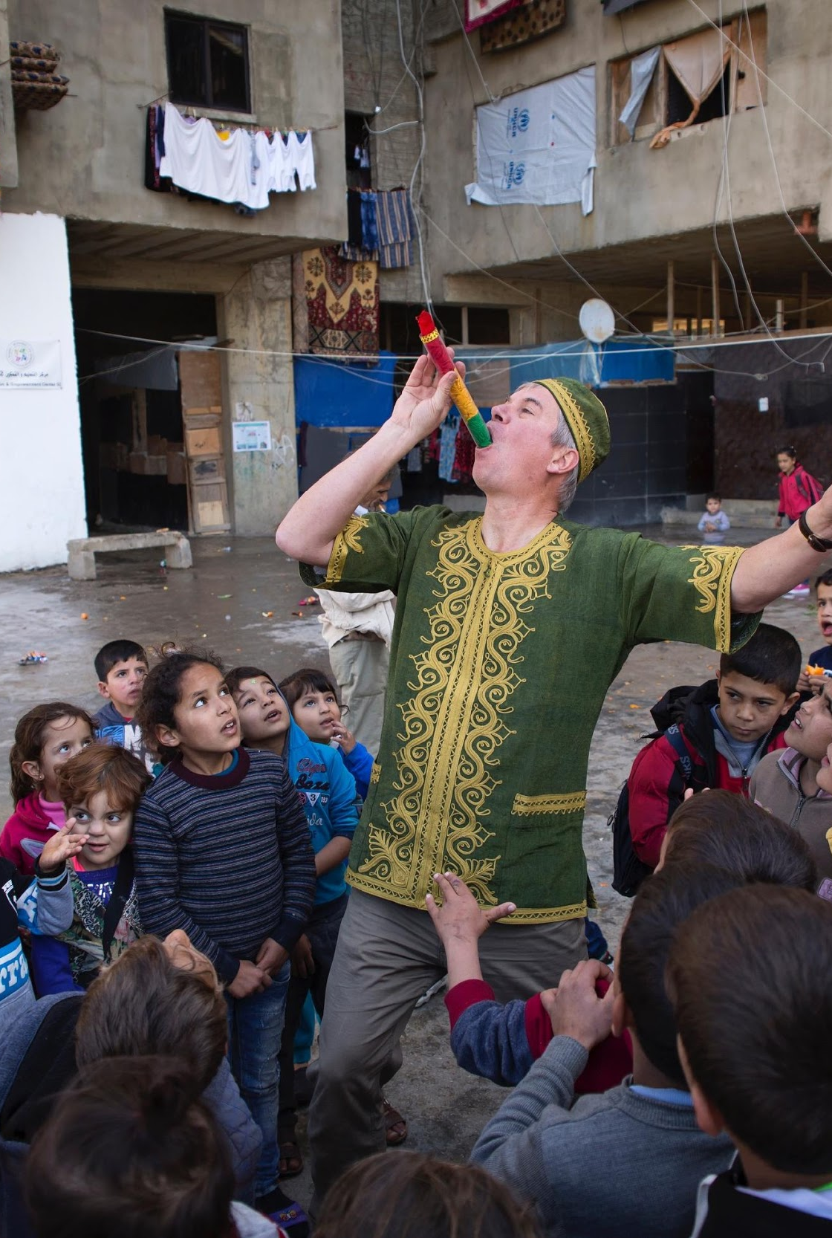
Magic for Smiles
Sevenoaks Welcomes Refugees Presents…
Join us for an extra special online magic show this Christmas. All proceeds go towards bringing magic to refugee children in the Middle East and beyond.
Tickets available on Eventbrite.com, search for “Magic for Smiles”
Friday 18 December 2020 6:30 – 7:30pm (UK)
Magic For Smiles UK Registered Charity Number 1182676
magicforsmiles.com

